Slide 1
Self-Healing Generative UI
AuraGen

Slide 2
AuraGen — Where We Are Now
Phase 1 → Phase 2 → Phase 3 → Phase 4 → Phase 5
Phase | Work | Status
1 | Problem understanding & project planning | ✅ Completed
2 | Next.js/React setup + UI foundation | ✅ Completed
3 | Mouse telemetry + movement analysis | ✅ Completed
4 | Friction/Cognitive Load Score | ✅ Initial implementation completed
5 | Real-time WebSocket communication | 🔄 Next
6 | LangChain + GPT integration | 🔄 Next
7 | Dynamic UI generation | ⏳ Pending
8 | Self-healing/adaptive UI | ⏳ Pending
9 | Testing & evaluation | ⏳ Pending
10 | Final documentation/demo | ⏳ Pending

Slide 3
PROJECT ARCHITECTURE
USER
INTERATION
TELEMETRY
FRICTION SCORE
COGNITIVE LOAD
WEBSOCKET
DECISION ENGINE
GAN AI
AST VALIDATION
PLAN VALIDATION
ADAPTATION TRIGGER
SELF-HEALING UI

Slide 4
FLOW PHASE
Telemetry
Cognitive Load
Decision
GenAI
Safety
Plan Validation
Self-Healing UI

Slide 5
Key Tech vs Purpose
Metric | Purpose
Friction Score | Interaction difficulty
Cognitive Load | Estimated user effort
Adaptation Count | Number of self-healing events
Successful Adaptations | Valid plans applied
AST Rejections | Unsafe plans blocked
AI Confidence | Model confidence
Response Time | Telemetry → adaptation
Improvement % | Before vs after adaptation

Slide 6
Project vs Task Step by Step Check list
Component | Status
Next.js / React UI | ✅ Complete
Professional dashboard | ✅ Complete
Mouse movement telemetry | ✅ Complete
Movement analysis | ✅ Complete
Friction Score | ✅ Complete
Cognitive Load estimation | ✅ Complete
Hesitation detection | ✅ Complete
WebSocket communication | ✅ Complete
Adaptation Decision Engine | ✅ Complete
GenAI integration | ✅ Complete
Safe Mock fallback | ✅ Complete
AST validation | ✅ Complete
Plan validation | ✅ Complete
Adaptation Trigger | ✅ Complete
Self-healing mechanism | ✅ Implemented
End-to-end backend pipeline | ✅ PASSED

Slide 7
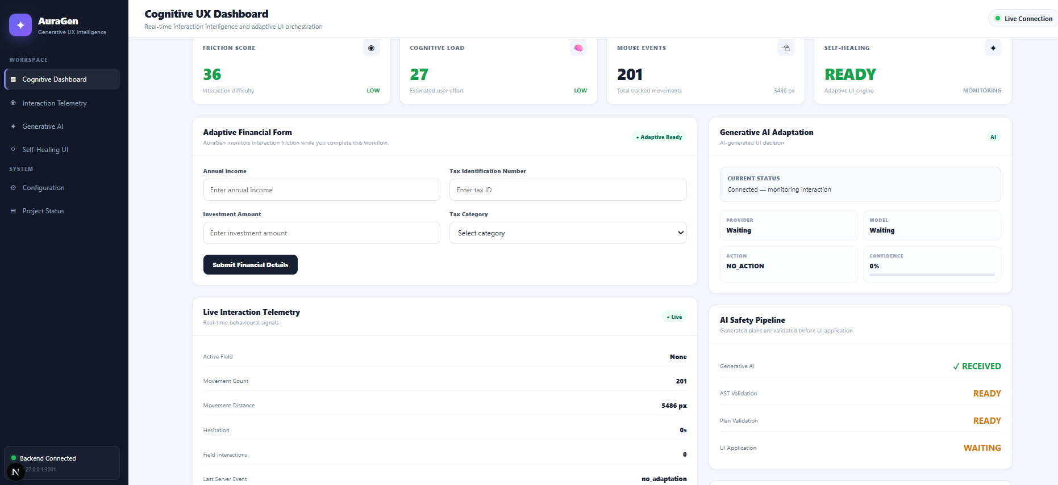

Slide 8
